Slide 1

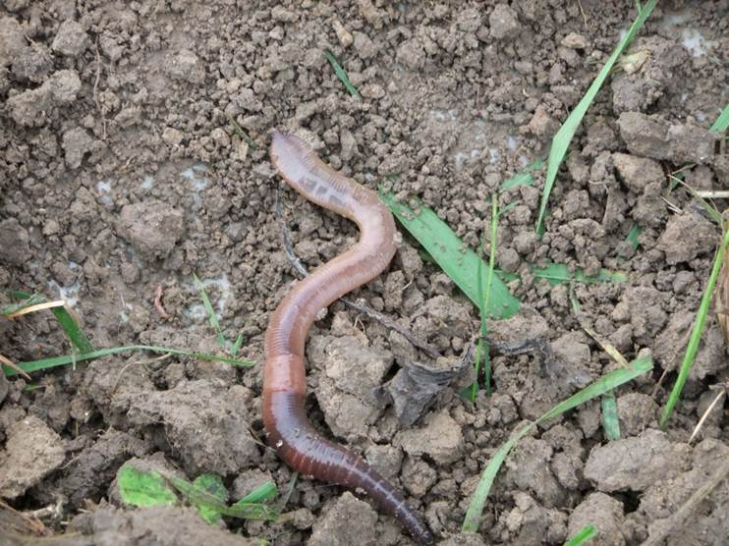
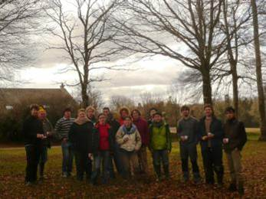
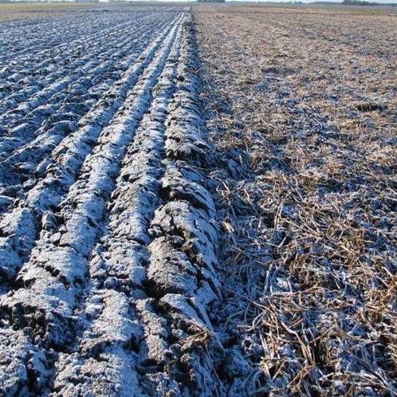
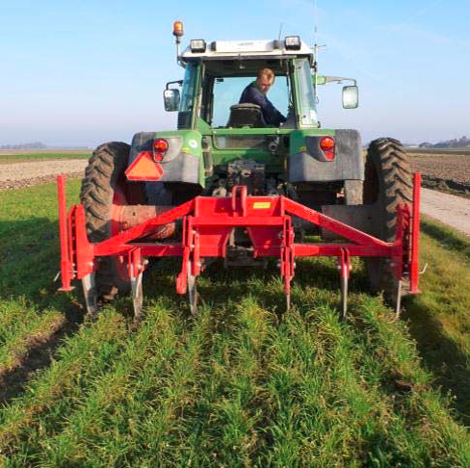
Soil ecology and agricultural technology;
An integrated approach towards sustainable soil management
Mirjam Pulleman, Guénola Pérès, Stephen Crittenden,
Djilali Heddadj, Wijnand Sukkel et al.

Slide 2
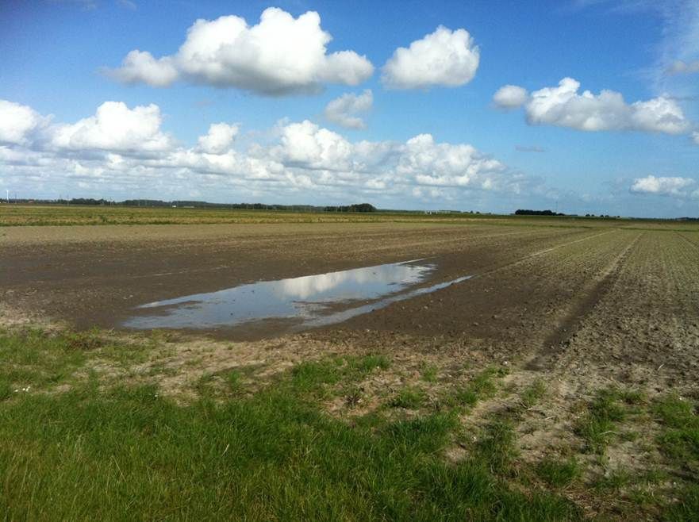
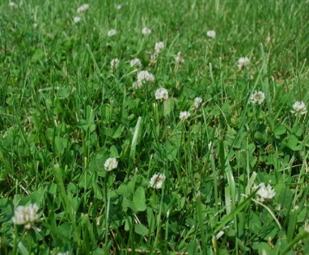
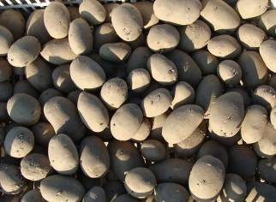
Tillage / Organic Farming
No-tillage and organic farming are 2 approaches that can enhance soil biodiversity and related soil functions / ESs
In NW Europe experiences with no-till are scarce but research and practice on various forms of reduced tillage is on the rise
Challenges include:
  Wet and cool climatic conditions
  Importance of tuber crops
  Use of heavy machinery
  The combination of organic and
  reduced tillage

Slide 3
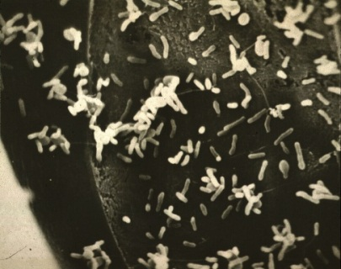
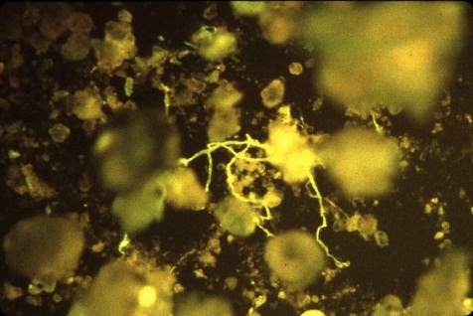
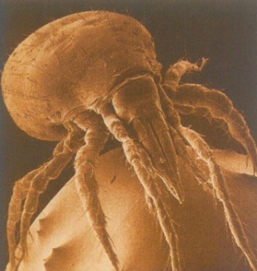
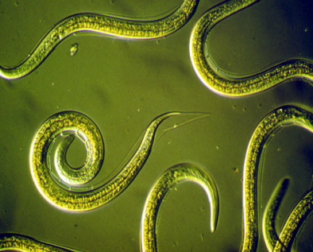
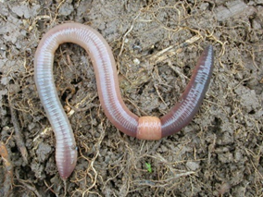
Soil management and sustainable farming
Improved nutrient retention / use efficiency
Maintenance of soil quality in the long term
More biological pest and disease control
Climate robust
Less dependent on non-renewables (e.g fossil fuels)
Bigger role for soil biodiversity and biological
regulation instead of external inputs
Support soil functions and ecosystem services (ESs)

Slide 4
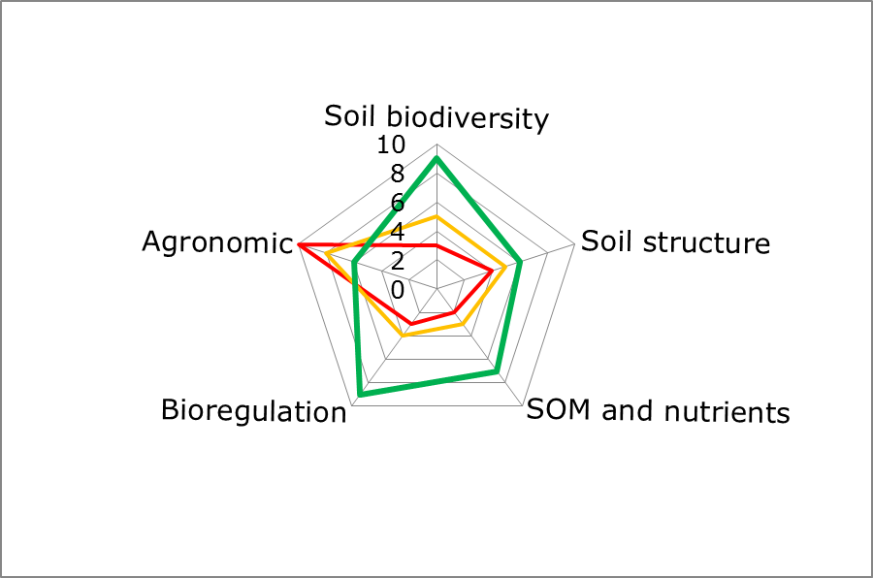
Soil management and sustainable farming
Integrated assessment and design
Which practices? Which indicators to use?

Slide 5
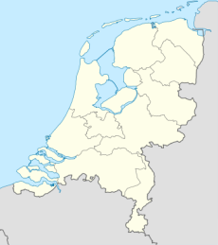
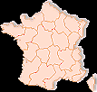


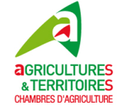


SUSTAIN Project
Snowman Network
Knowledge for Sustainable Soils
Documenting & systematizing reduced tillage practices (conventional and organic crop rotations)
Evaluate impact on soil biodiversity and soil functions across sites
Develop indicators and tools to evaluate and communicate the effects of soil management on soil biodiversity and multiple ESs

Slide 6
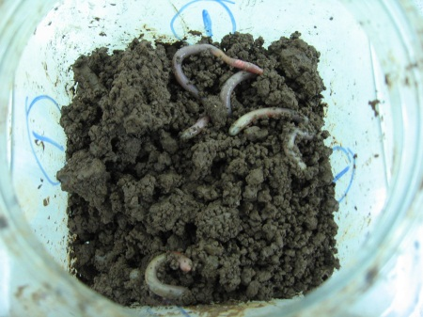
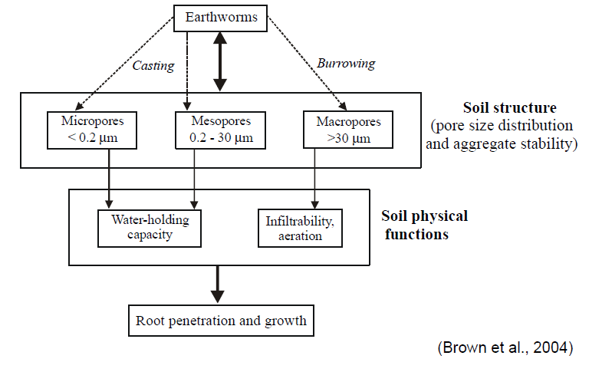
SUSTAIN Project
Soil biodiversity:
→ Earthworm and nematode taxa as indicator organisms
(known response to soil management and effects on soil functions)
Soil functions / ecosystem services:
→ Soil organic matter, N cycling
→ GHG mitigation
→ Soil structure
→ Soil physical functions
→ Food production

Slide 7
Earthworm functional groups
(response & effect)
No worms
Anecic
Epigeic
Endogeic
Courtesy JW van Groenigen

Slide 8
Sites and practices
Flevoland (Netherlands)
Marine loam soils (reclaimed)
Arable crop rotations:
Potatoe, Sugarbeet, Onion
Carrot
Cereals (Wheat, barley)
Grass clover
Cover crops
<2% reduced tillage, but increasing
Brittanny (NW France)
Dystric Cambisols (loamy)
Arable crop rotations:
Maize, cereals
Rapeseed
Alfalfa, cover crops
± 25% reduced tillage
Organic
Notes:
Brittany, Soil derived from micaschist. Precipitation Flevoland: 800 mm yr-1. Climatic conditions more or less comparable
FKA Crop rotation (4 years) : grain maize-wheat-rape-wheat-phacelia; FKO Grain-maize – triticale – buckwheat – Protein pea – triticale – alfalfa – alfalfa – triticale – grain-maize - wheat

Slide 9
Sites and practices
2 Experiments
(n=4)
A) Organic (2008)
Mouldboard plough 25cm (P)
Harrowing 8cm +chisel (NIT)
Harrowing 8cm (MinT)
B) Conventional (2008)
Mouldboard plough 25cm (P)
Harrowing 8cm +chisel (NIT)
Harrowing 8cm (MinT)
2 Experiments (n=3)
A) Organic (since 2003)
- Mouldboard plough 25cm (dP)
Mouldboard plough 15cm (sP)
Harrowing 8cm +chisel (sNIT)
Harrowing 15cm +chisel (dNIT)
B) Conventional (since 2000)
- Mouldboard plough 25cm (dP)
- Harrowing 8cm +chisel (sNIT)
- No till, direct seeding (DS)
+ different fertilizer/manure
treatments
Notes:
FKA Crop rotation (4 years) : grain maize-wheat-rape-wheat-phacelia; FKO Grain-maize – triticale – buckwheat – Protein pea – triticale – alfalfa – alfalfa – triticale – grain-maize - wheat

Slide 10
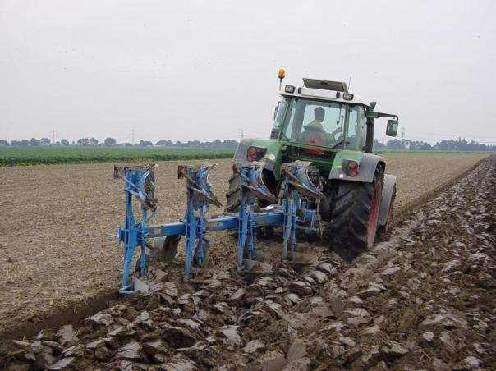
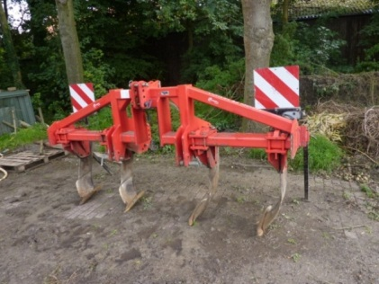




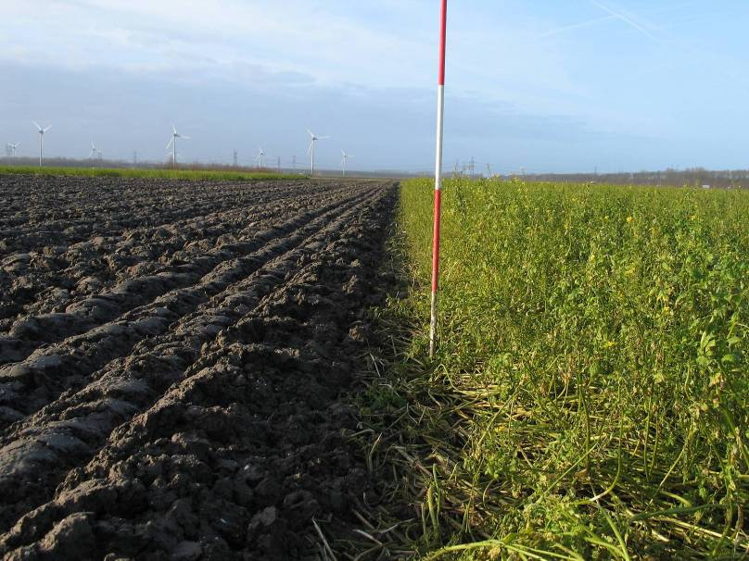
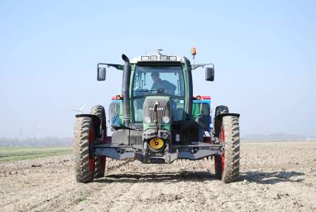
Sites and practices (NL)
P
NIT
MinT
8 cm
20 cm
25 cm
All with controlled traffic lanes
Crittenden et al 2014, Applied Soil Ecology

Slide 11
Soil biodiversity; earthworms
NL: Fall 2009-2012, before ploughing
Farming system |  | Conventional (no m-2) |  |  |  | Organic (no m-2)
Tillage treatment |  | P | MinT | NIT |  | P | MinT | NIT
Fall 2009 | Spring barley | 95 | 110 | 169 | Winter wheat; mustard | 389 | 415 | 289
Fall 2010 | Onions; rye grass | 279 | 208 | 358 | Carrots; white clover | 357 a | 159 b | 104 b
Fall 2011 | Potatoes | 192 | 245 | 127 | Wheat/Faba bean | 841 a | 560 b | 555 b
Fall 2012 | Sugar beet | 123 b | 263 a | 308 a | Potatoes; grass clover | 723 | 797 | 804
P ≤ NIT / MinT
MinT / NT ≤ P
Crittenden et al 2014, Applied Soil Ecology
Notes:
J92b en J10-6

Slide 12
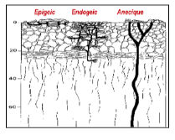
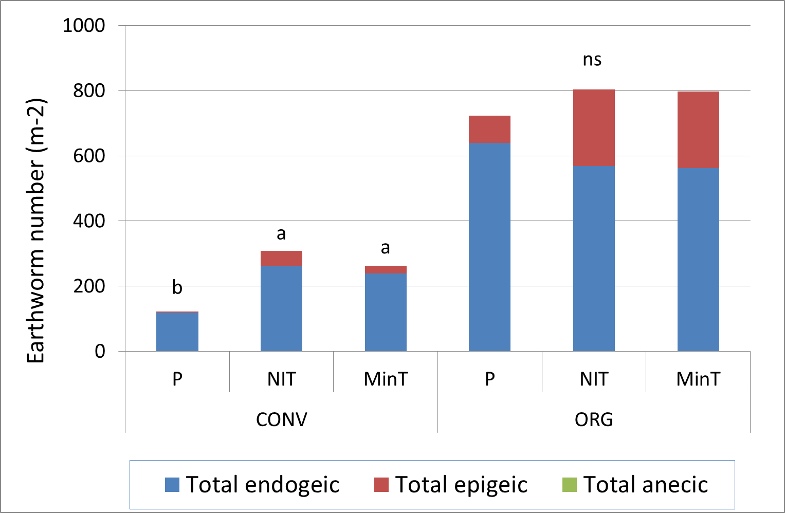
Soil biodiversity; earthworms
NL: Fall 2012; 4yr after start tillage experiment

Slide 13
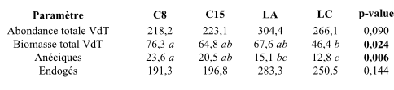
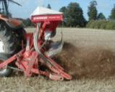

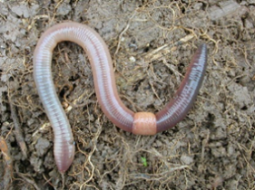
Soil biodiversity; earthworms
Brittany 2012 Organic; 9 yrs after
Deep plough (dP)
Shallow NIT (sNIT)
Deep NIT (dNIT)
Shallow plough (sP)
Total Abundance (no m-2)
Biomass (g m-2)
Anecique (g m-2)
Endogeic (g m-2)
OM inputs/
Organic?
N. giardi – L. terrestris
earthworm abundance
endogeic abundance
Reduced tillage
+
Earthworm species diversity
anecic abundance (FR) / epigeic abundance (NL)
(different species)

Slide 14
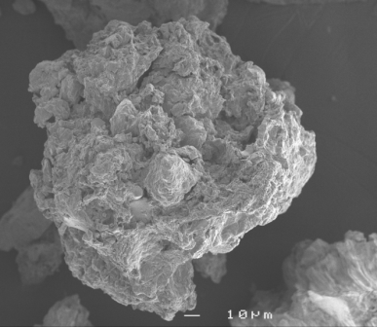
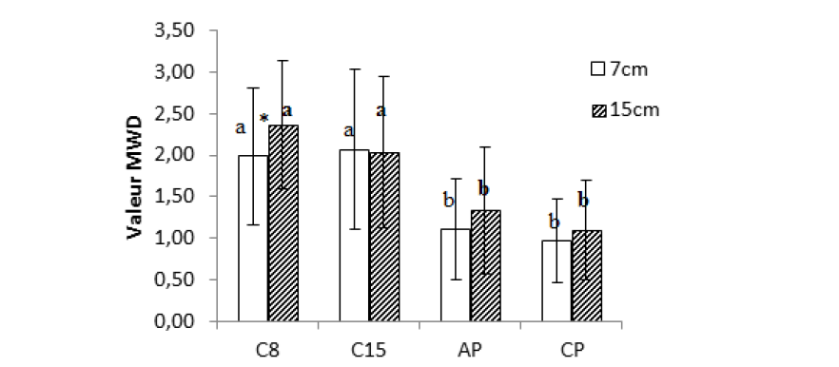
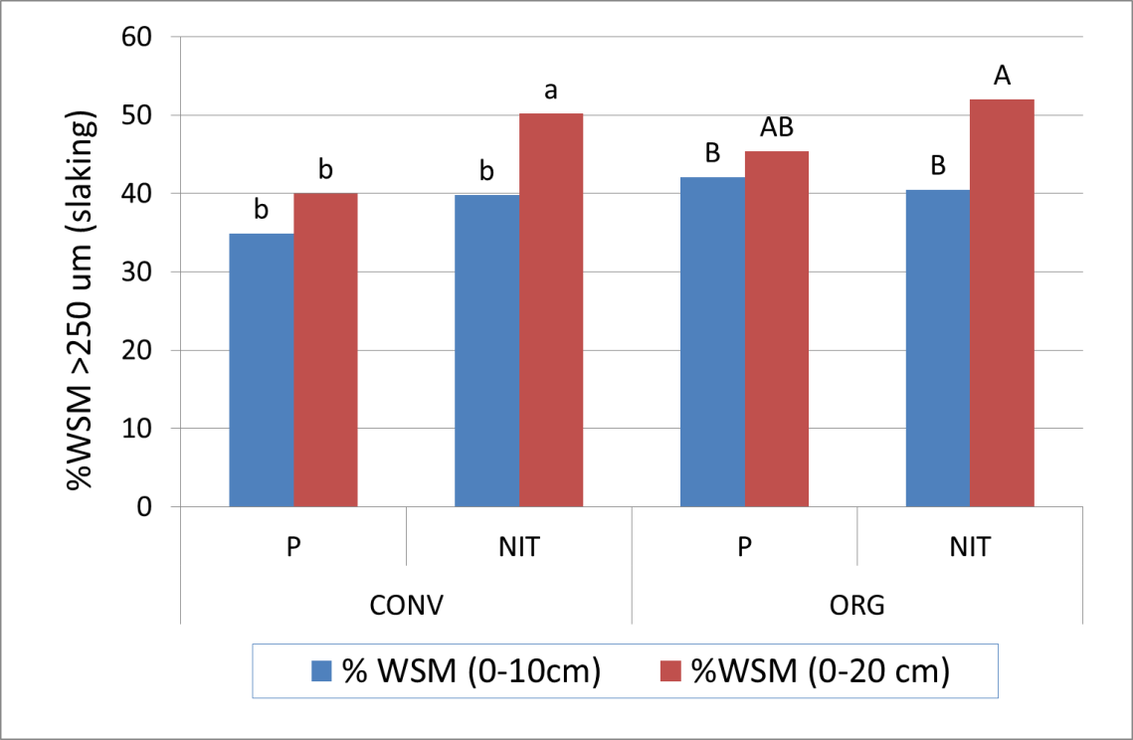
Soil functions & ESs; soil structure
Brittany 2012 Organic; 9 yrs after
MWD (mm) after slow wetting
NL: 2012; 4yr after start tillage experiment
sNIT
dNIT
sP
dP
Le Bissonais versus
Elliot & Six’ method, but
similar patterns observed

Slide 15
Soil functions & ESs; food production
NL:
Cereals generally yield better under NIT in organic farming
Root crops tend to yield less in reduced tillage => no clear relation with weeds
NIT offers opportunities to widen the use / growing time of grass clover & cover crops
Brittany:
Lower yields under reduced tillage, strongly related with weed pressure

Slide 16
Conclusions & outlook
Reduced tillage practices without soil inversion positively affect earthworm communities, SOM stratification and aggregate stability across sites
Earthworm abundance is mostly affected by organic farming / inputs, tillage affects functional diversity -> can be mutually supportive
Indicator selection: Total abundance & % of anecics + epigeics
Effects on yields are site and crop dependent: challenges: tuber crops and weed control (organic)
NIT offers opportunities to widen the use of cover crops with benefits for soil biodiversity, structure, SOM, nutrients

Slide 17
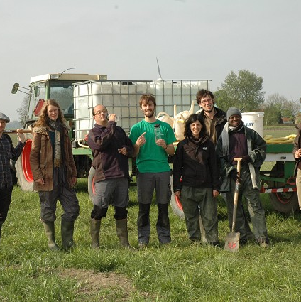
Thanks to:
Snowman Network
And all colleagues on the SUSTAIN project

