Slide 1
Soil tillage effects on earthworm populations and species diversity in arable farming systems
- Temporal and spatial dimensions -
Mirjam Pulleman, Stephen Crittenden, Tamilarasi Eswaramurthy, Ron de Goede, Joana Frazão & Lijbert Brussaard

Slide 2
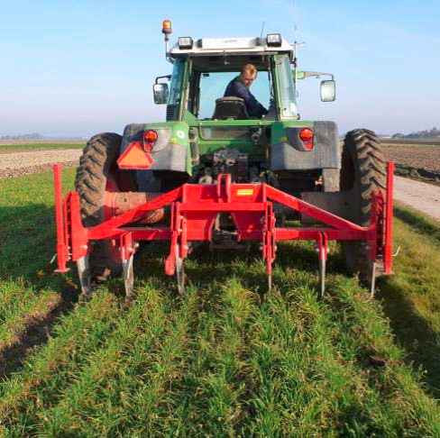
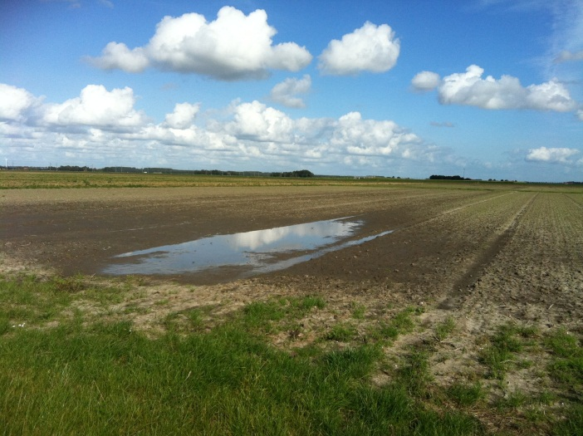
Earthworms & Soil Tillage
Earthworms strongly affect soil structure, soil organic matter dynamics and soil physical processes
They are considered important soil quality indicators in agricultural soils but are negatively affected by soil tillage
The benefits of earthworms are among the reasons for farmers in NL to have a growing interest in reduced tillage systems

Slide 3
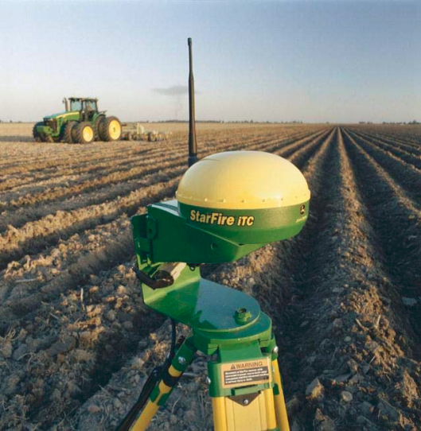
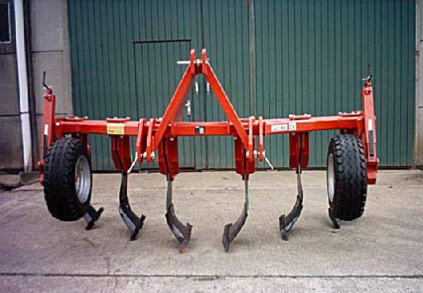
But....
Direct seeding (no-till) not feasible in the Netherlands
Economic importance of tuber crops
Soil compaction due to use of heavy machinery
No chemical weed control in organic farming
Non-inversion tillage (NIT) combined
with controlled traffic

Slide 4
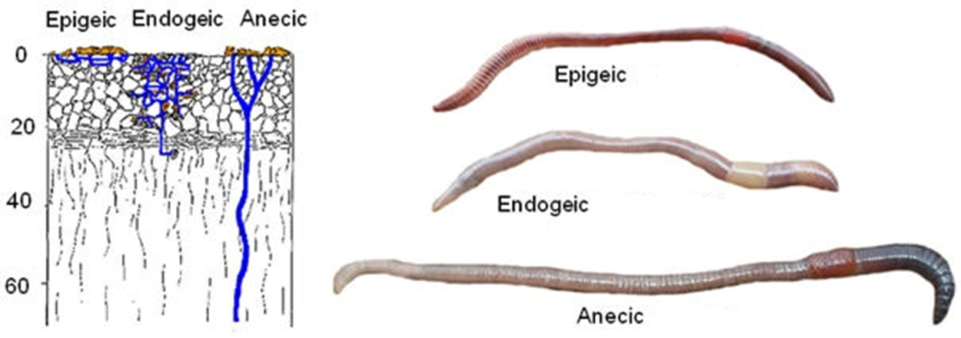
And....
Need to consider a diversity of different species!
Notes:
INCLUDE CANOCO ANALYSIS??? SLIDE JOANA DIFFERENT FUNCTIONAL GROUPS

Slide 5
Objectives and hypothesis
The effects of Conventional Tillage, based on mouldboard ploughing (CT), vs. Non-Inversion Tillage (NIT) on the density and diversity of different earthworm species
H1: Ploughing has an immediate negative effect on earthworm populations and this effect is species dependant
H2: In the medium and long-term this leads to higher earthworm densities and diversity under NIT, compared to CT

Slide 6
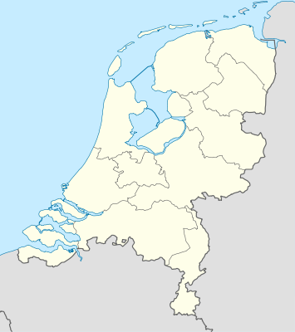
Materials & methods
Flevopolder, the Netherlands - reclaimed land (1950’s)
Soil: Calcareous marine clay loam
Two field experiments at the same location:
Organic farming system
Conventional farming systems

Slide 7
Materials & methods
Situation 2011
CONVENTIONAL
ORGANIC
NIT vs. CT system
Started in 2009
CRB Design, 4 blocks
Onion
Wheat/Faba bean
Sugar beet
Grass-clover
Potato
Carrot
I
III
Wheat
Cabbage
II
IV
Potato
Onion

Slide 8
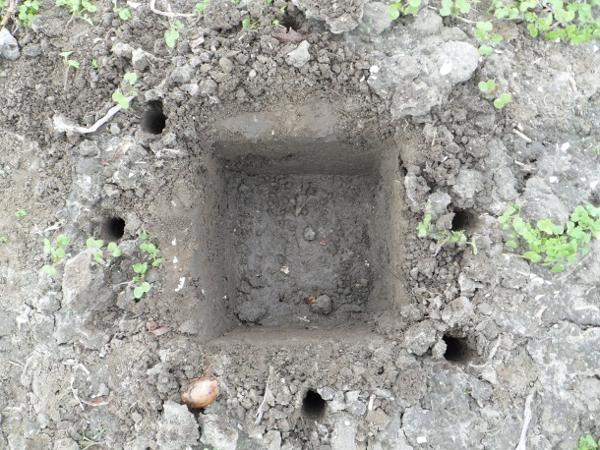
Materials & methods
Before ploughing
After 2 days
After 2 weeks
After 1 month
Short- and medium* term effects of ploughing on earthworm populations (fall 2011):
3 (20*20*20)cm³ monoliths per tillage treatment X 4 Blocks
Handsorting + formaldehyde (>20 cm)
Spring 2009
Fall 2009
Fall 2010
Spring 2011
Fall 2011
*Sampling in May / November (before fall ploughing)

Slide 9
Materials & methods
Situation 2011
CONVENTIONAL
ORGANIC
Onion
Wheat/Faba bean
Potato
Short-term effects
Medium-term effects
Parcels not used
Cabbage

Slide 10
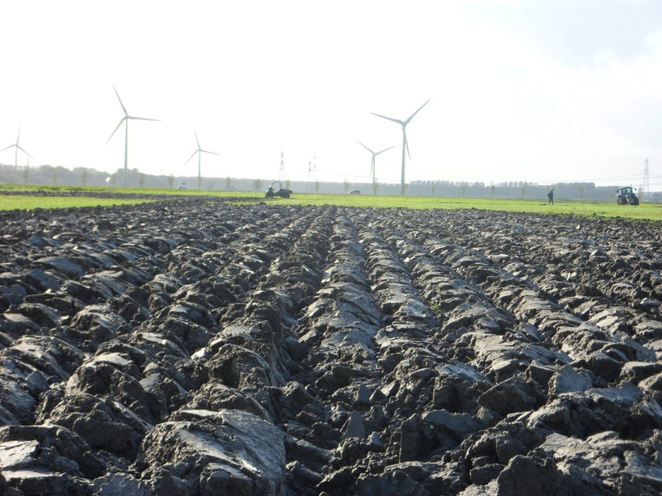
Results -Short term effects of ploughing (2011)-

Slide 11
Short-term effects (CONV-ONION)
a
A
A
A
A
b
bc
c
Notes:
75% reduction

Slide 12
Short-term effect (CONV-ONION)
 | Before ploughing |  | 2 days |  | 2 weeks |  | 1 month |  | Relative abundance (%)
 | NIT | CT | NIT | CT | NIT | CT | NIT | CT | NIT | CT
Endogeic
A.calignosa | + | + | + | + | + | + | + | + | 85 | 81
A.rosea | + | + | + | + | + | + | + | + | 11 | 8
E. tetraeda | - | + | + | + | + | + | + | + | 2 | 9
Epigeic
L.rubellus | + | + | + | - | + | - | + | - | 1 | 2
L.castaneus | - | - | - | - | + | + | + | - | 0.3 | 0.3
Anecic
L.terrestris | - | + | - | - | - | - | - | - | 0 | 0.3
Nr. of species: | 3 | 5 | 4 | 3 | 5 | 4 | 5 | 3
Notes:
Dominantly endogeic. Epigeic and anecic disappeared after ploughing but can be dilution effect given low abundance
!!Results for Organic Cabbage crop were very similar, despite higher absolute numbers (>1000) and relatively bigger role for epigeics

Slide 13
Results -Medium term effects (2009-2011)-

Slide 14
Medium-term effects (CONVENTIONAL)
Notes:
2011: Potato crop. No sign. effect of tillage in any season

Slide 15
Medium term effects (CONVENTIONAL)
 | 2009 |  | 2010 |  | 2011 |  | Relative abundance (%)
 | NIT | CT | NIT | CT | NIT | CT | NIT | CT
Endogeic
A.calignosa | + | + | + | + | + | + | 83 | 93
A.rosea | + | + | + | + | + | + | 4 | 7
E. tetraeda | - | - | - | + | + | - | 1 | 0
A.chlorotica | + | - | - | - | - | -
A.limic | - | - | - | + | - | -
Epigeic
L.rubellus | + | - | + | - | + | - | 11 | 0
L.castaneus | + | - | + | - | - | - | 1 | 0
Anecic
L.terrestris | - | - | - | - | - | - | 0 | 0
Nr. of species | 5 | 2 | 4 | 4 | 4 | 2
Notes:
Again dominated by endogeics though the role of epigeics especially rubellus seems to be increased in NIT. No anecics

Slide 16
Medium-term effects (ORGANIC)
Notes:
2011 Onion crop. Species not shown. Similar to CONVENTIONAL, but relatively bigger role for epigeics

Slide 17
Summary of results
Fall ploughing reduced earthworm numbers (by 75% between 2 days – 1 month after the event)
Similar response in organic and conventional farming, but 2-3 x higher absolute numbers
In the medium-term, earthworm density was not increased by NIT. In the organic parcel, the earthworm density was even higher under CT in the last 3 seasons
Endogeic species strongly dominated (>86%), in particular A. calignosa.
The relative importance of epigeics (especially L. rubellus) was higher under NIT
Anecics were (virtually) absent

Slide 18
Discussion – the temporal dimension?
History of arable land use with ploughing since land reclamation has strongly selected for an earthworm community that is dominated by an endogeic species that is highly adapted to mechanical disturbance and incorporation of soil organic matter.

Slide 19
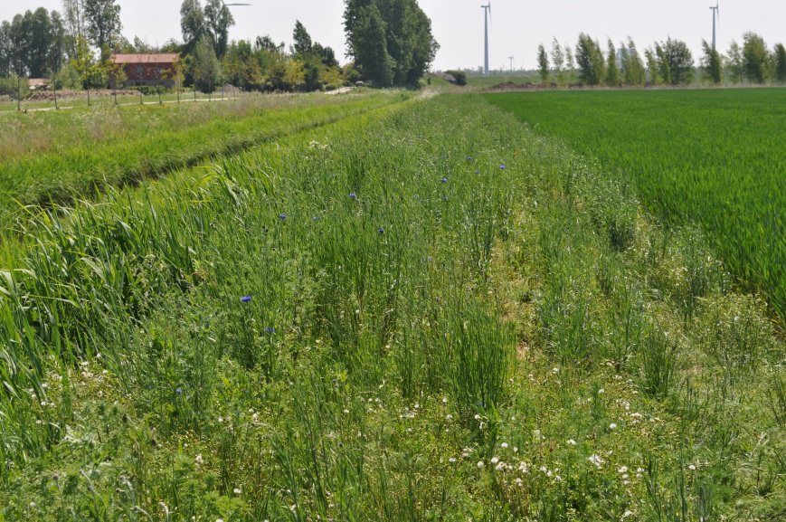
Discussion – the spatial dimension?
In on-farm tillage experiments on similar soil but a more diverse landscape setting a large variation in species composition in response to NIT was found (including anecics!)
What role for landscape complexity and semi-natural habitat on farm as a source for colonization of arable land after tillage reduction?
Need for a better understanding of the links between agricultural management and earthworm response traits to generalize across environments
Notes:
For generalizing across environments and understanding variation in response

Slide 20
Thank you for your attention!
Poster Joana Frazão
P

Slide 21
Short-term effects (ORGANIC-CABBAGE)
A
A
A
A
a
a
b
c
Notes:
Earthworm abundance in the organic field under cabbage crop
Maximum abundance goes till 1,300 earthworms per m2 under NIT
AT every time of sampling Nit has significantly In Organic, even before tillage - NIT have significantly higher number of earthworms when compared with CT
No significant difference between NIT
After ploughing– earthworms density as started reducing , however , it not significantly higher. But at 2 weeks after, the level of earthworm no reduction is significantly higher than before plough.
and there was a sign of recovery between 2weeks and 1 month of plough.
Tillage ; As expected immediately after plough there was no effect on earthworm no, Before tillage there was a significant difference,
after 2 weeks there was an effect
and there was significant difference between 2 days after plough sampling and 2 weeks after plough P value=0.013
No difference between 2 days and 1 month after plough
there was significant difference between 2 weeks after plough and 1 month after plough P value=0.003

Slide 22
Taxonomic species diversity (Organic)
Time of sampling | Before Plough |  | After 2 days |  | After 2 weeks |  | After 1 month |  | Relative abundance
Species/Tillage | NIT | CT | NIT | CT | NIT | CT | NIT | CT | NIT(%) | CT(%)
Endogeic
A.calignosa | + | + | + | + | + | + | + | + | 81 | 85
E. tetraeda | + | - | + | + | + | - | + | + | 2 | 0.44
A.rosea | + | - | + | - | + | + | + | + | 2 | 1
A.chlorotica | + | - | + | + | + | - | - | + | 1 | 0.44
Epigeic
L.rubellus | + | + | + | + | + | + | + | + | 13 | 12
L.castaneus | - | - | + | - | + | - | - | - | 1
Anecic
L.terrestris | - | - | - | - | - | - | + | + |  | 1
Species Richness | 5 | 2 | 5 | 4 | 6 | 3 | 5 | 6
Notes:
In the organic field we found maximum 6 species, due to the presence another endogeic species A. Cholortica.
Before plough we found 5 species in NIT and 2 species in CT , where after 1 month of ploughing there were 6 no of species in CT, this is caused by more no of endogeic species after ploughing
Other interesting point is epigeics are present in all stages of ploughing which contributes around 12 to 13 % to .total earthworm population

Slide 23
Taxonomic species diversity (Organic)
Year | 2009 |  | Fall 2010 |  | 2011 |  | Species Abundance
Species/Tillage | NIT | CT | NIT | CT | NIT | CT | NIT (%) | CT (%)
Endogeic
A.calignosa | + | + | + | + | + | + | 57 | 71
E. tetraeda | + | + | + | + | + | + | 18 | 13
A.rosea | + | + | + | + | + | + | 4 | 5
A.Chlorotica | + | + | - | - | - | -
Epigeic
L.rubellus | + | + | + | + | + | + | 20 | 11
L.castaneus | + |  | + | - | - | - | 1
Anecic | - | - | - | - | - | -
L.terrestris | - | - | - | - | + | -
Species Richness | 5 | 5 | 5 | 4 | 5 | 4
Notes:
Species richness are more or less same in both tillage treatments
Epigeics are present in both tillage treatments under organic system
CT plots species composition was made by higher 70% of A.calignosa followed by tetratedra and rubulleus
in Nit plots species composition was made only 57% A.calignosa remaining population was made by all other species, mainly rubuleus
Emphasis anecics are not present.

