Slide 1
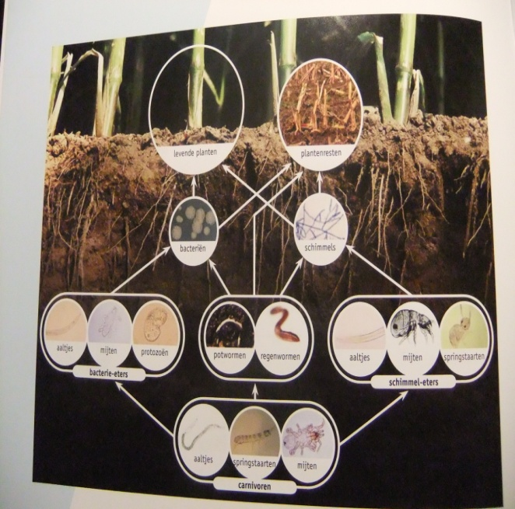
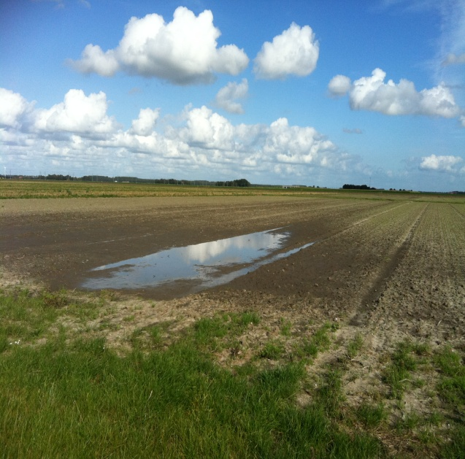
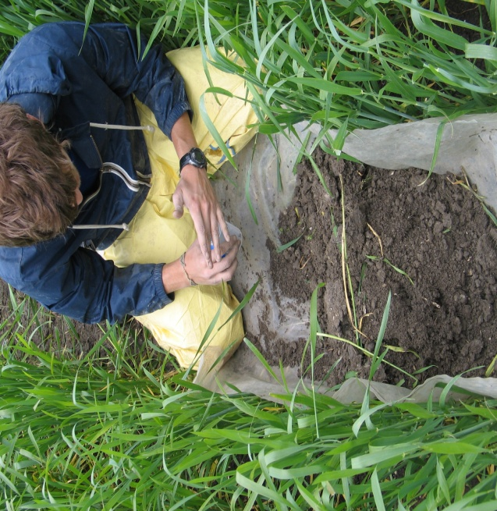
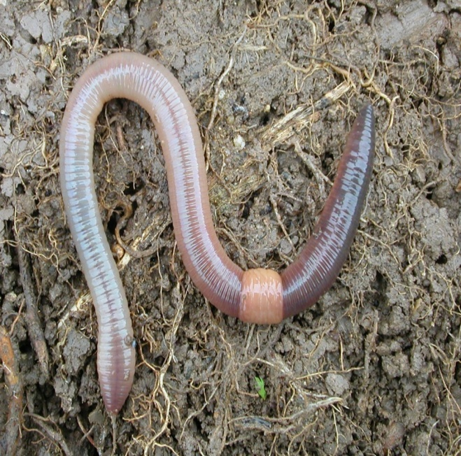
Biological soil properties & functions as affected by tillage system
Results from NL sites
February 26, 2014

Slide 2
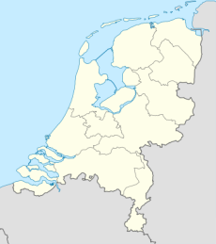
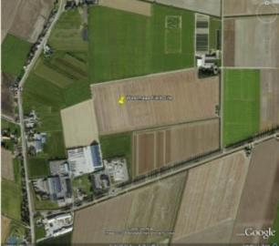
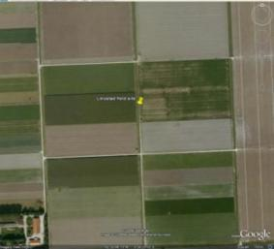
NL field sites – Marine clay loam soils
Lelystad RCBD field experiment
(different tillage systems for conventional and organic crop rotations
Hoeksche Waard
Farmers fields and experimental farm with conventional crop rotations

Slide 3
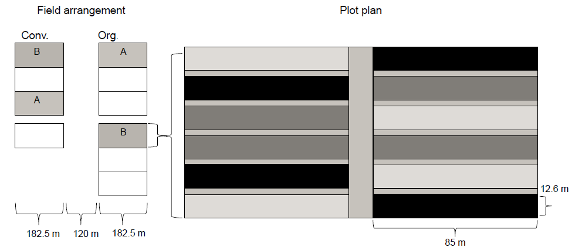


Lelystad field trial
Minimum tillage (MT)
Non-inversion tillage (NIT)
Conventional tillage (CT)
Block (n=4)

Slide 4
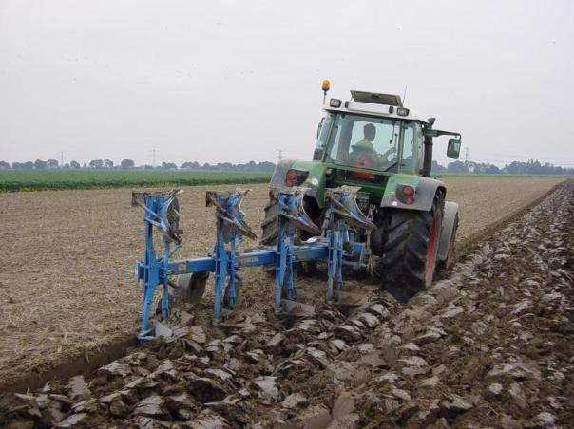
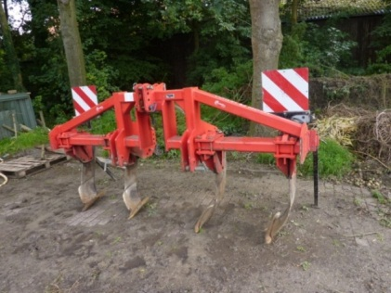

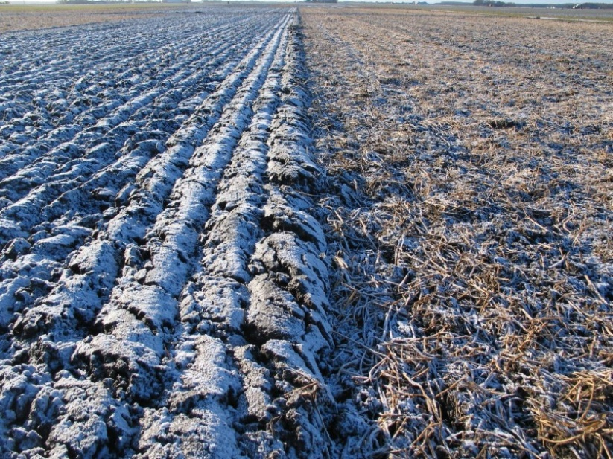


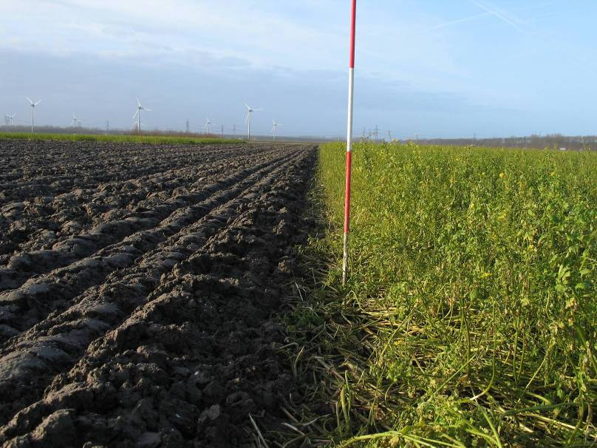
Lelystad field trial
CT
NIT
MT
8 cm
20 cm
25 cm
All with controlled traffic lanes

Slide 5
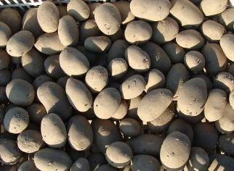
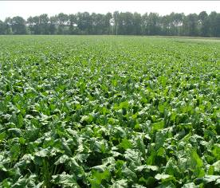
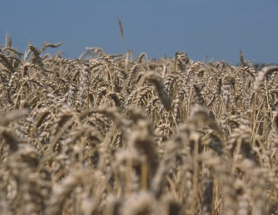
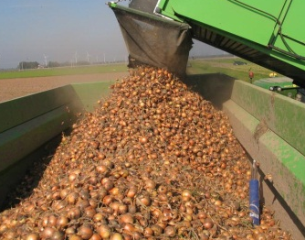
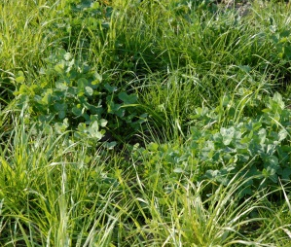
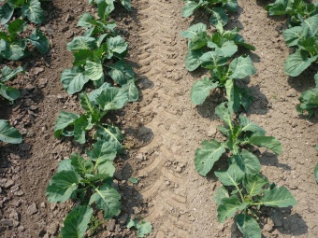
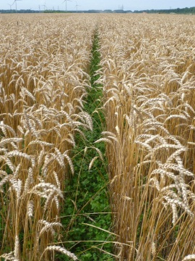
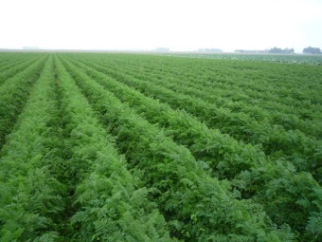
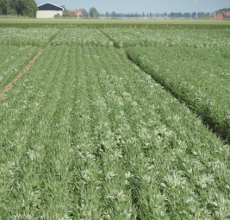
Lelystad field trial
Conventional crop rotation (synthetic fertilizers)
potato sugar winter onions
beet wheat
Organic crop rotation (animal manure)
potato grass white spring carrots s. wheat clover cabbage wheat beans
+ use of green manure where possible

Slide 6
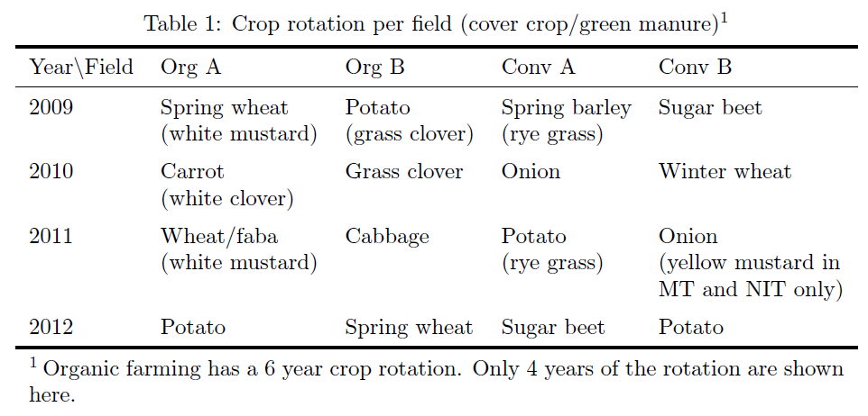
Lelystad field trial
Crittenden et al 2014 (in press)

Slide 7
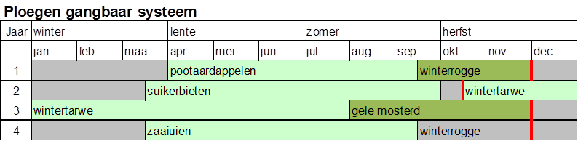
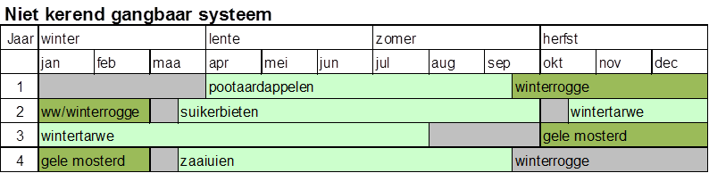
Multifunctional crop rotation gangbaar

Slide 8
Multifunctional crop rotation biologisch

Slide 9
Lelystad field trial
Measurements 2009-2013:
Earthworm populations 2009-2011 (Crittenden et al. 2014, APSOIL) & 2012 (Oudshoorn, 2013)
Nematode feeding groups and microbial parameters 2009 & 2012 (PPO & RIVM)
Soil physical characteristics (compaction, infiltration, pF, aggregate stability)
Soil OM/C
Soil N (including N2O) (PPO)
Crop yields (PPO)
NB: not all data are available for all parcels all years

Slide 10
Lelystad field trial
Measurements 2009-2013:
Earthworm populations 2009-2011 (Crittenden et al. 2014, APSOIL) & 2012 (Oudshoorn, 2013)
Nematode feeding groups and microbial parameters 2009 & 2012 (PPO & RIVM)
Soil physical characteristics (compaction, infiltration, pF, aggregate stability)
Soil OM/C
Soil N (including N2O) (PPO)
Crop yields (PPO)

Slide 11
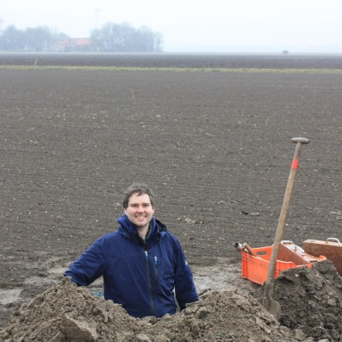
Results; Earthworms (2009-2011)
Crittenden et al 2014 (in press)

Slide 12
Results; Earthworms (2009-2011)
Crittenden et al 2014 (in press)

Slide 13
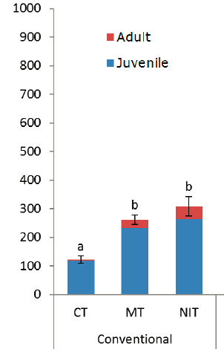
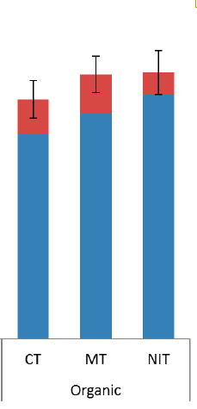
Results; Earthworms Fall 2012
Data: Oudshoorn 2013
Conventional J9-2b
Organic
Organic J10-6

Slide 14
Results; Earthworms Fall 2009-2012
Sampling date |  | Conventional J9-2b |  |  |  | Organic J10-6
Tillage system |  | CT | MT | NIT |  | CT | MT | NIT
Fall 2009 | Spring barley | 95 | 110 | 169 | Winter wheat; mustard | 389 | 415 | 289
Fall 2010 | Onions; rye grass | 279 | 208 | 358 | Carrots; white clover | 357 a | 159 b | 104 b
Fall 2011 | Potatoes | 192 | 245 | 127 | Wheat/Faba bean | 841 a | 560 b | 555 b
Fall 2012 | Sugar beet | 123 b | 263 a | 308 a | Potatoes; grass clover | 723 | 797 | 804
Organic
Organic
Data: Bas Oudshoorn

Slide 15
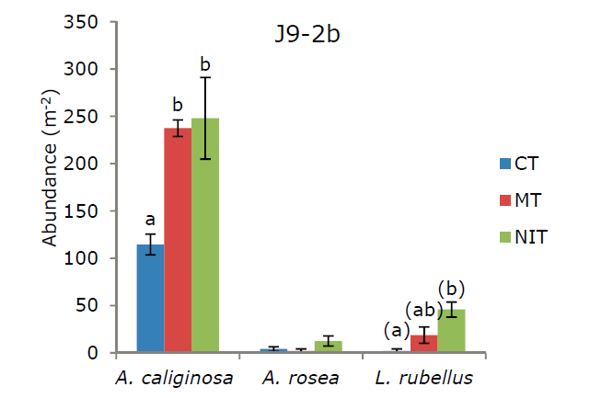
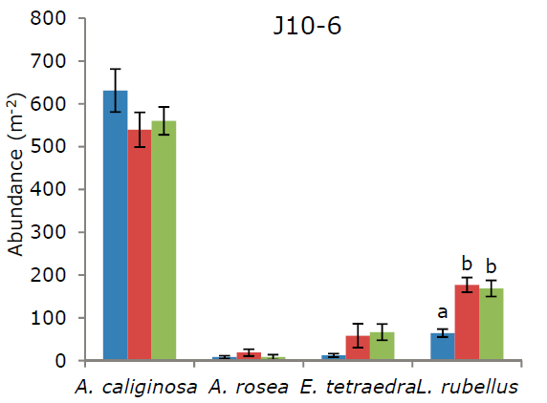
Results; Earthworm species
Conventional J9-2b
Species composition all yrs
Endogeic species:
A. caliginosa (65-85%)
A. rosea
A. chlorotica (<1%)
Epigeic species:
L. rubellus (CT<MT/NIT)
E. tetraedra
L. castaneus (<1%)
S. mammalis (<1%)
Anecic species
A. longa (<1%)
L. terrestris (<1%)
Organic J10-6
Crittenden et al. 2014 Oudshoorn, 2013

Slide 16
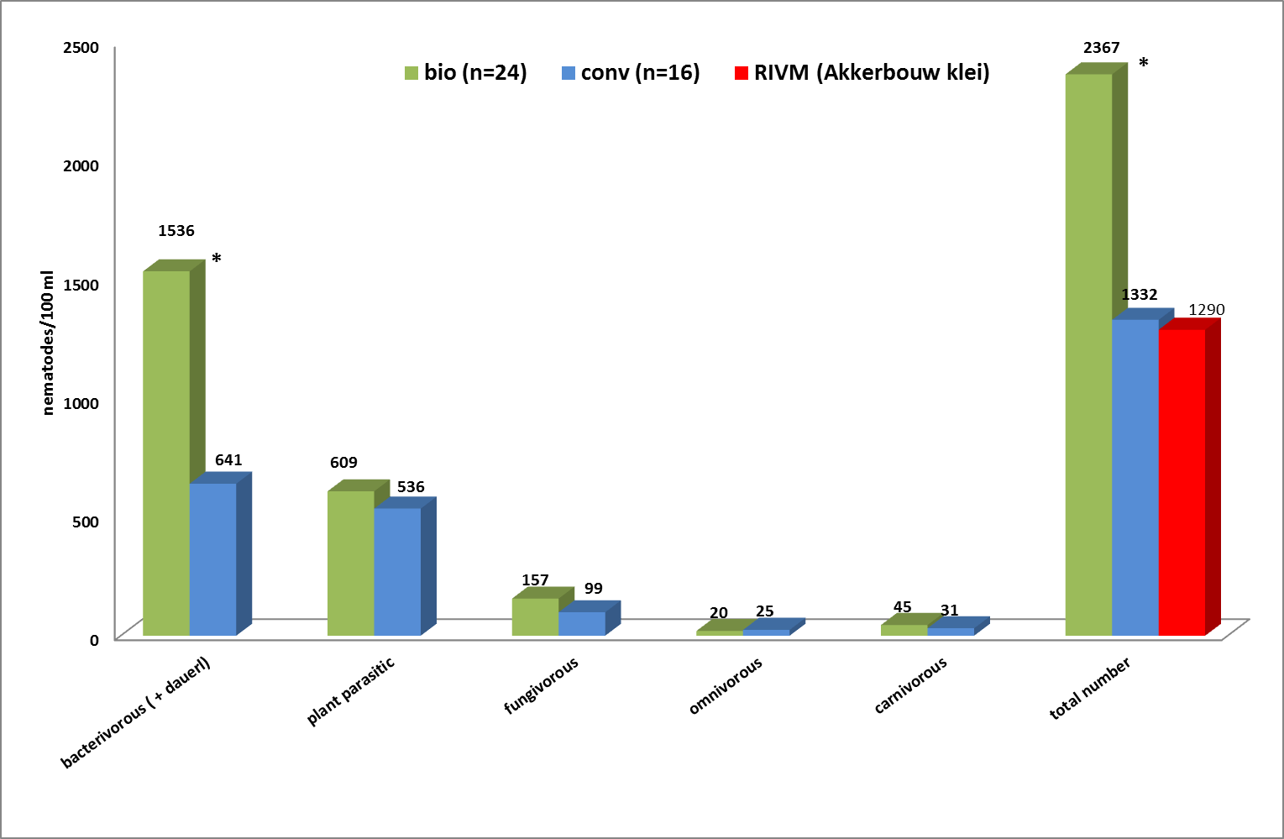
Results; Nematode feeding groups
Data PPO, Gerard Korthals - 2009 baseline data? (0-25 cm depth)

Slide 17
Nematode Guild Analysis
Calculation of functional indices, nematode guild analysis
Maturity index (MI) (r-k life strategies, disturbance indicator)
Enrichment index (EI) (nutrient status)
Structure index (SI) (soil ecosystem stability)
Basal index (BI) (disruption)
Channel index (CI) (bacterial- or fungal decomposition)

Slide 18
Nematode Guild Analysis
Calculation of functional indices, nematode guild analysis
Structured
Basal
M
B
E
Enriched
Om₄
Om₅
omnivores
3.2
5.0
Ba₁
Ca₂
Ca₃
Ca₄
Ca₅
carnivores
3.2
0.8
1.8
3.2
5.0
cp-1
Fu₂
Fu₃
Fu₄
Fu₅
fungivores
0.8
1.8
3.2
5.0
Fu₂
Enrichment trajectory
Ba₂
Ba₃
Ba₄
Ba₅
0.8
bacterivores
cp-2
0.8
1.8
3.2
5.0
cp-2
cp-3
cp-4
cp-5
Structure trajectory

Slide 19
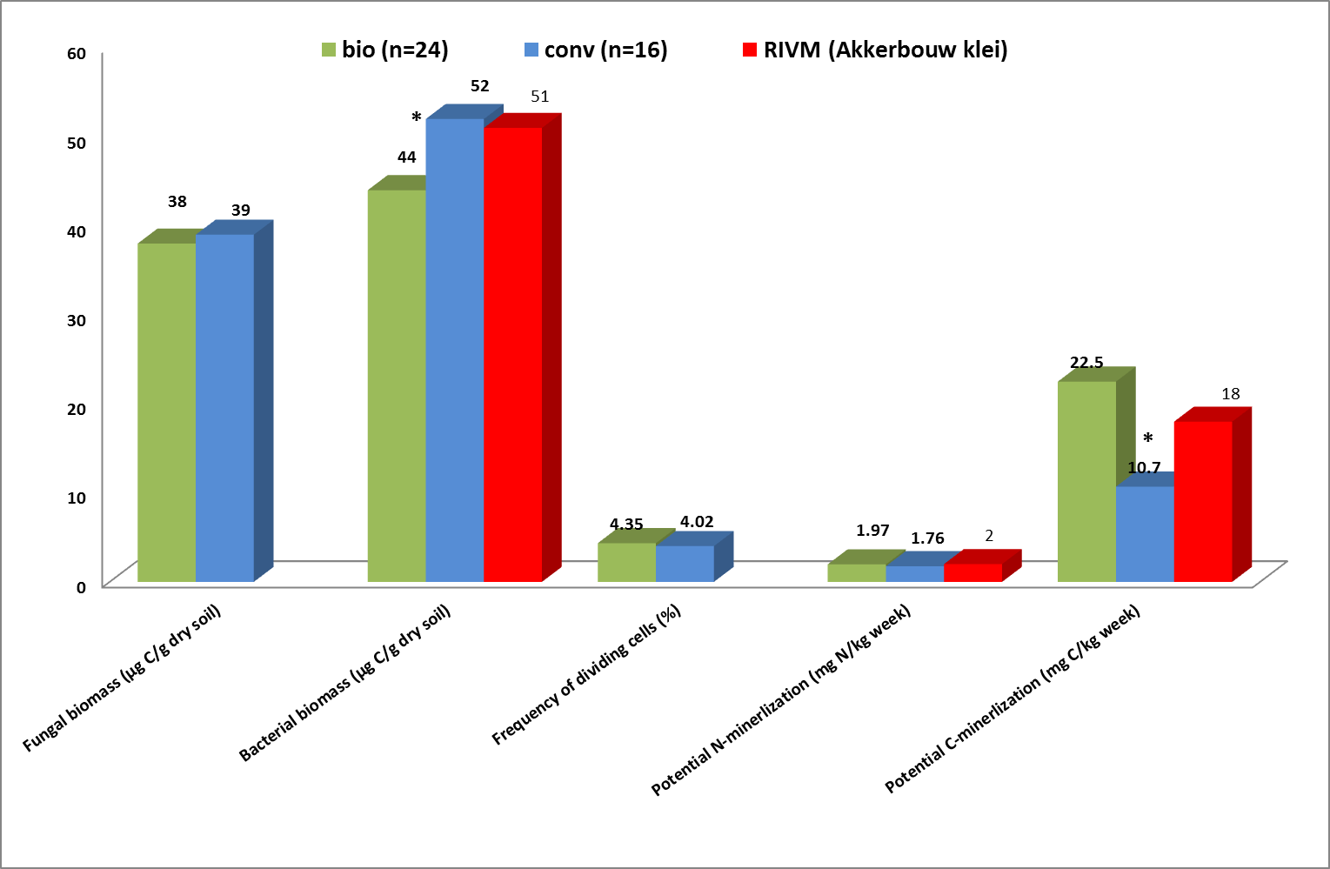
Results; Microbial parameters
Data PPO, RIVM, Alterra- 2009 baseline data? (0-25 cm depth)

Slide 20
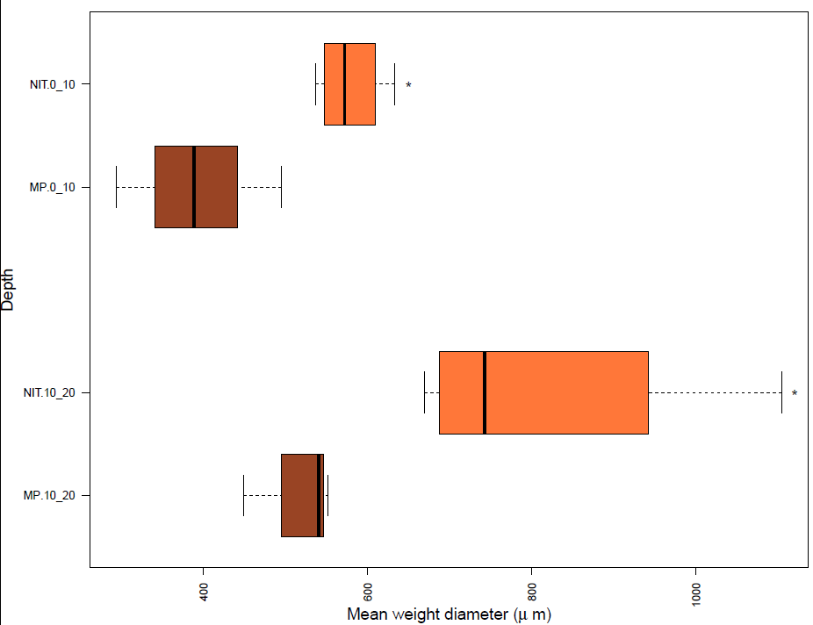
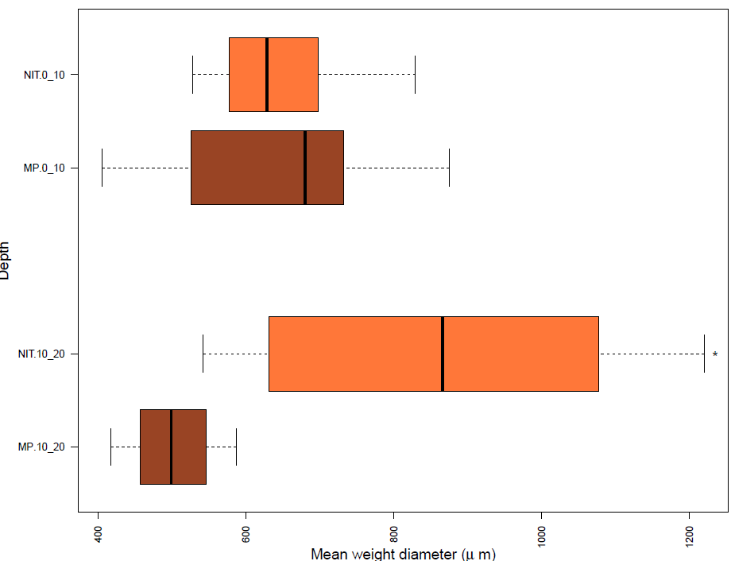
Results; soil physical characteristics
Aggregate stability 2011-2012
Conventional J9-2b
Organic J10-6
Data: Crittenden et al in prep.

Slide 21
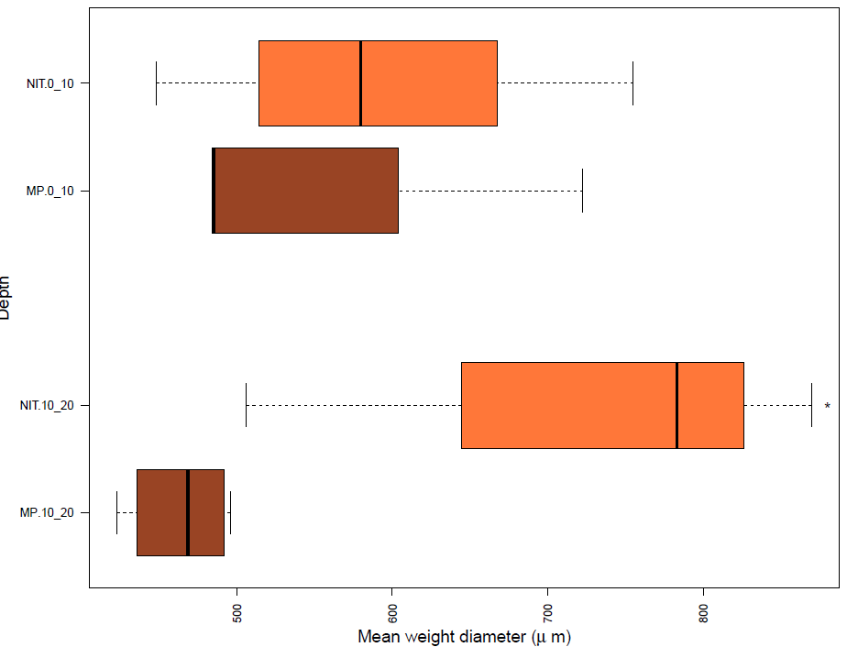
Results; soil physical characteristics
Aggregate stability 2011-2012
Organic J10-6
Organic J10-3
Data: Crittenden et al in prep.

Slide 22
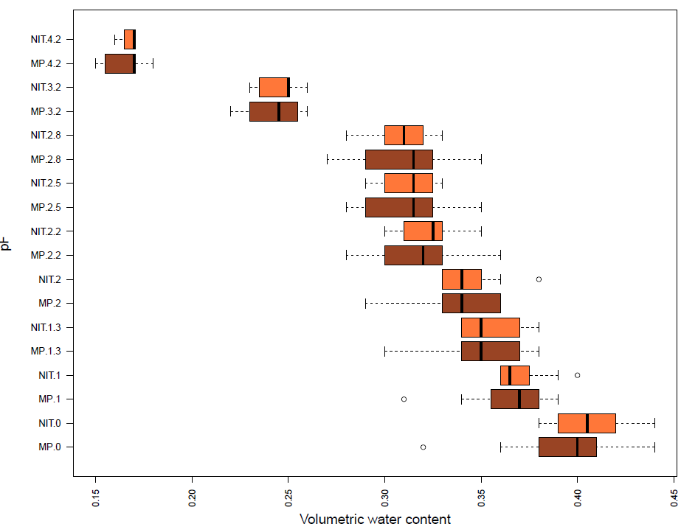
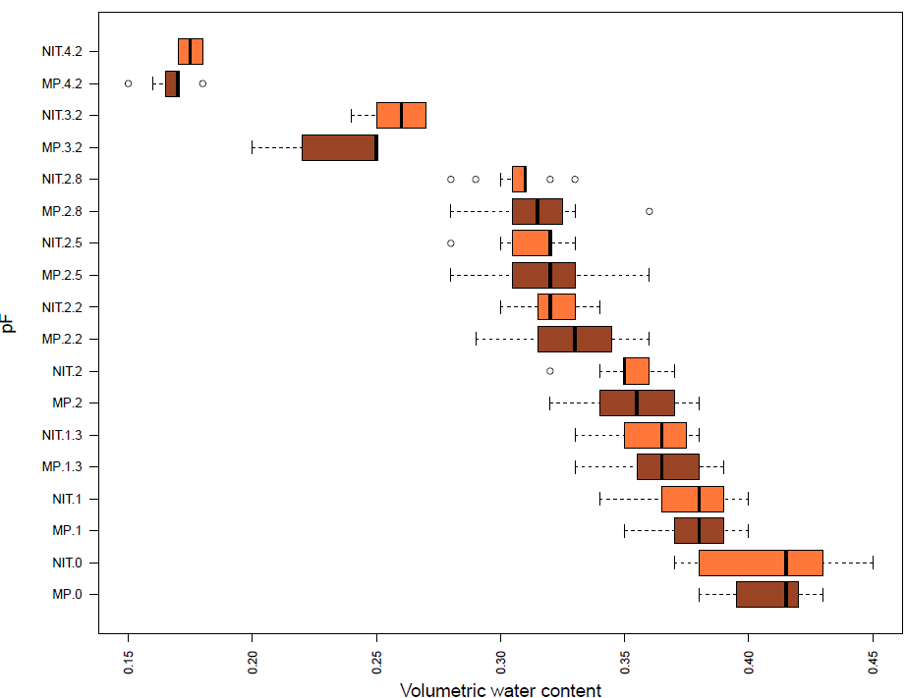
Results; soil physical characteristics
pF 2011-2012
Organic J10-6; 0-5 cm
Organic J10-6; 10-15 cm
Data: Crittenden et al in prep.

Slide 23
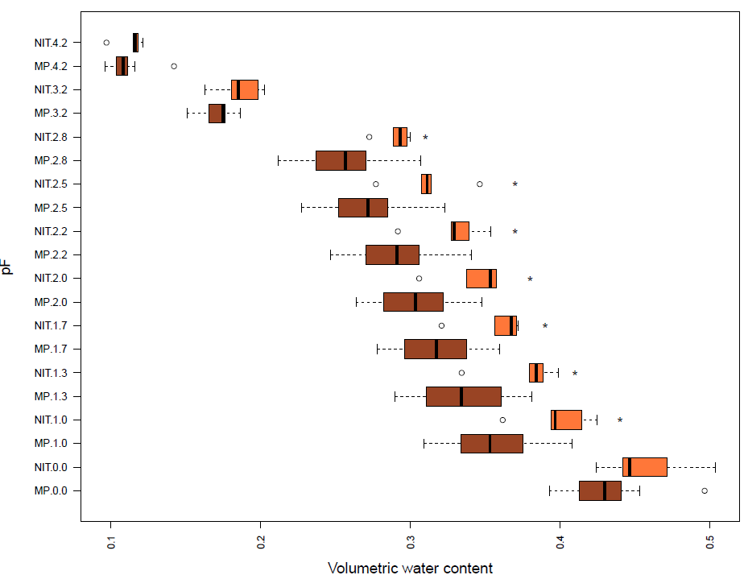
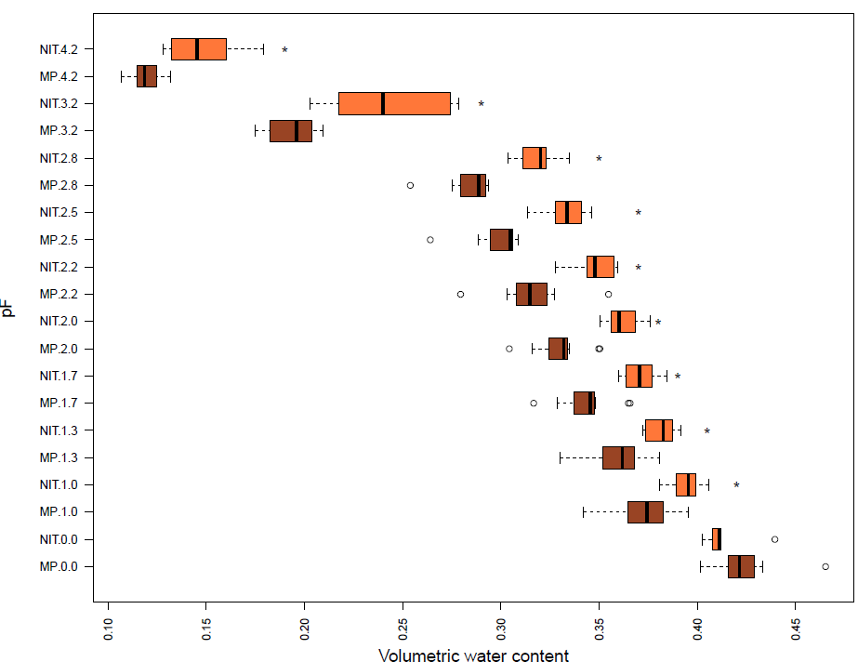
Results; soil physical characteristics
pF 2011-2012
Organic J10-3; 0-5 cm
Organic J10-3; 10-15 cm
Data: Crittenden et al in prep.

Slide 24
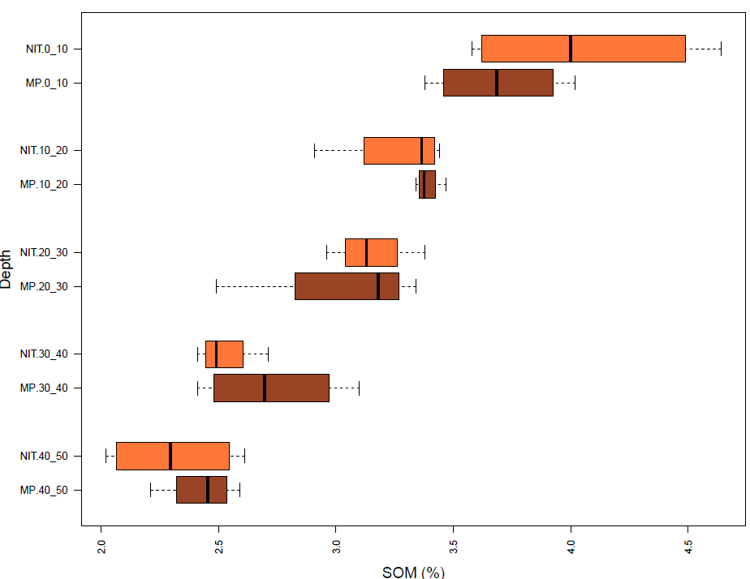
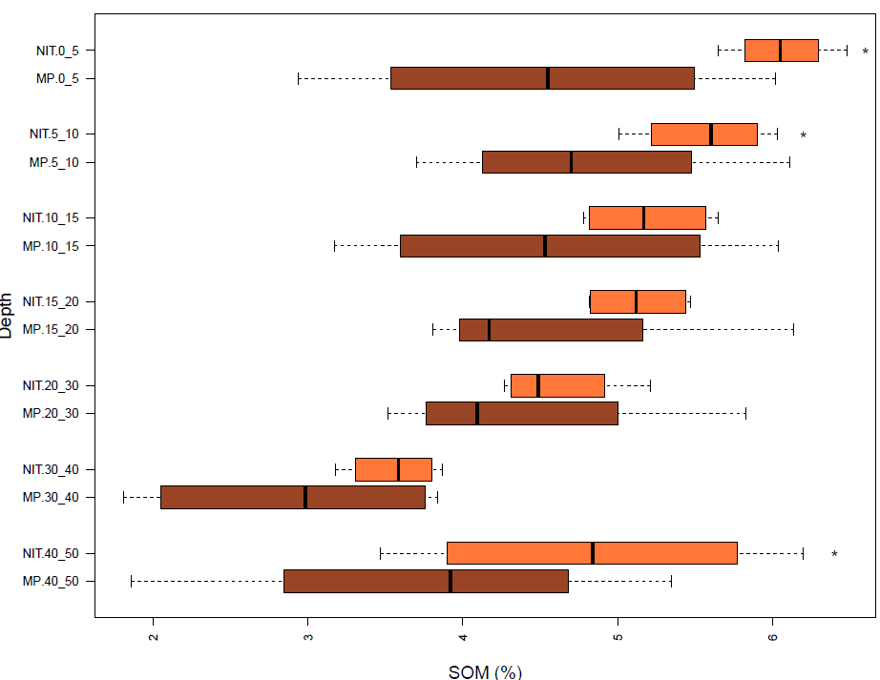
Results; soil organic matter
SOM 2011-2012
Organic J10-6
Organic J10-3
Data: Crittenden et al in prep.

Slide 25
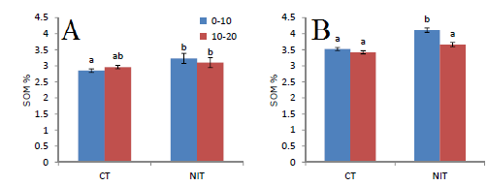
Results; soil physical & OM/C 2012
Data: Bas Oudshoorn
Conventional J92b
Organic J10-3

Slide 26
Results; Soil C stocks 2011
No net C sequestration (P_{T}=0.911)
  ST: 88±4 Mg/ha
  NIT: 89±4 Mg/ha
Data: Natasja Poot
Organic J10-6

Slide 27
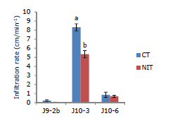
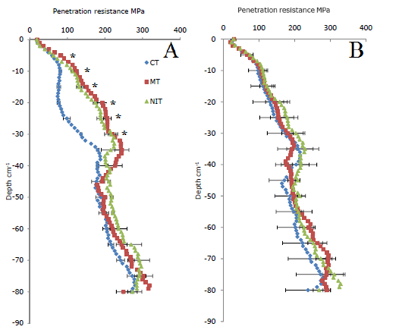
Results; more soil physical characteristics
Data: Poot 2012; Oudshoorn 2013
Conventional
Organic
Conventional J9-2b
Organic J10-6
Organic J10-6

Slide 28
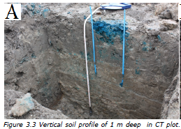
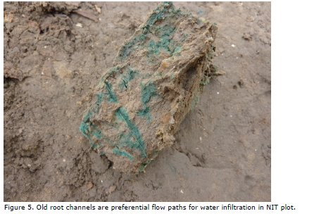
Results; soil physical 2012
Data: Bas Oudshoorn
Conventional
Organic
Notes:
It was shown that the cracks made with the NIT implement caused lateral flow but also sandy layers: The assumption of vertical flow can be questioned

Slide 29
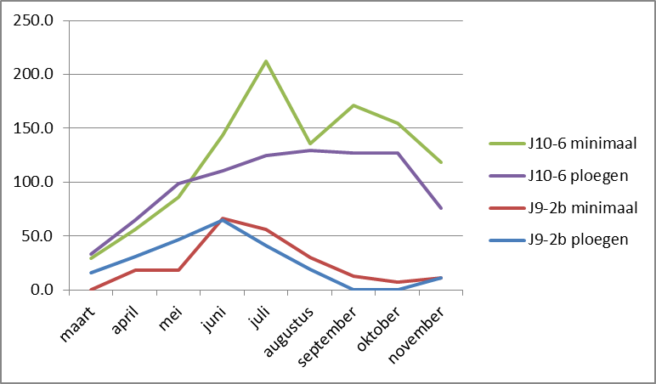
Mineralisatieveldjes 2012
Nmin 0-30 cm kg/ha

Slide 30
Results; crop yields
Data: PPO
Notes:
It was shown that the cracks made with the NIT implement caused lateral flow but also sandy layers: The assumption of vertical flow can be questioned

Slide 31
Discussion / conclusions
Large variation in earthworm densities between parcels and years
Very much dominated by A. caliginosa
When sign. tillage effects are found: Different response in organic farming than in conventional farming.
Hypothesis that NIT would increase total ew numbers is not confirmed
L. rubellus increases under NIT, anecics virtually absent
Can anecics survive in our arable fields?
=> Results also confirmed in farmers fields (Crittenden et al, ms submitted)

Slide 32
Discussion / conclusions
Higher aggregate stability in NIT, especially at 10-20 cm
Higher SOM content in NIT with time (top 15 cms only and only sign. in one of the two parcels) => No net C sequestration
Higher compaction in NIT based on penetrometer readings
Measurement of water infiltration with double ring method? What are we measuring?
Yields: lower for NIT in some crops (esp. carrot), higher for others (grass/cereals), but also dependent on year

Slide 33
Discussion / conclusions
Soil physics: quantification and translation to ecosystem services?
Proxies for ecosystem services? LCA? Scale? Functional unit?
Do we have information about desired levels or ranges for proxies / soil quality indicators? (prototyping).

Slide 34
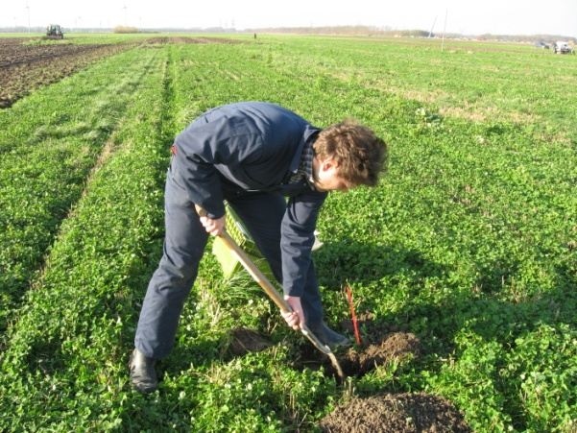
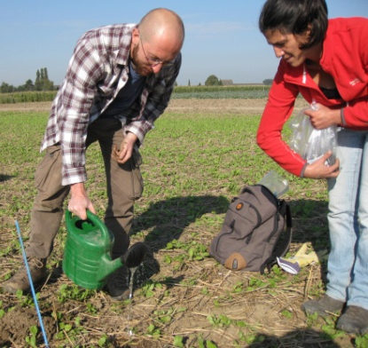
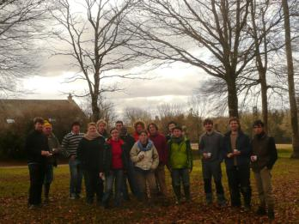
Thanks to:
Steve Crittenden,
Joana Frazão
Ron de Goede (WU)
Bas Oudshoorn, Natasja Poot, Tamila Eswaramurthy (MSc students)
Wijnand Sukkel, Derk van Balen, Gerard Korthals (PPO)
.. and all SUSTAIN colleagues

Slide 36
Communication 2013-2014
2013 Newsletter
  Soil physical effects
  Soil chemical effects (organic matter, N)
  Soil biology (nematodes, microbial)
2014: NIT Hand book in cooperation with Network of Practice on Reduced Tillage Farming
Presentations for farmers
Conference presentations (EGU, Green Carbon)

Slide 37
Handbook NIT
Yields: PPO
Weed control: advisor
Pests: advisor
Diseases ?
Soil structure: PRI
N dynamics: LBI, PPO
Earthworms: Wageningen Univ.
Soil health: PRI
Practical crop management: advisors

Slide 38
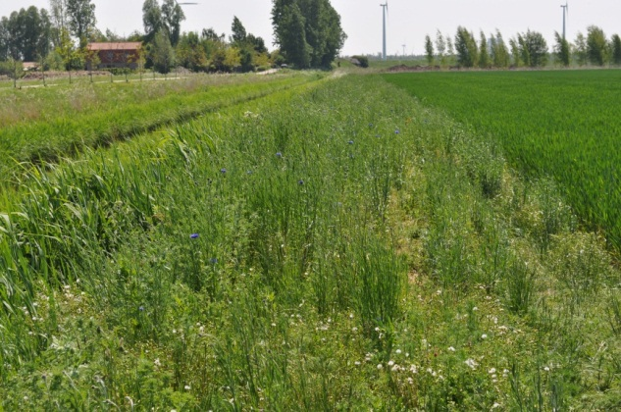


Farmers fields – marine loam soils
Effects of NIT and field margin strips
3 commercial farms and one field station in the Hoeksche Waard

Slide 39
Farmers fields – marine loam soils
  Traditional practice:
  - Max. 12 species of earthworms in arable fields
  - Appr. 200 ind m-2
Crittenden et al. in prep.

Slide 40



Farmers fields – marine loam soils
Crittenden et al. in prep.

Slide 41
Farmers fields – marine loam soils
Crittenden et al. in prep.

